Slide 1
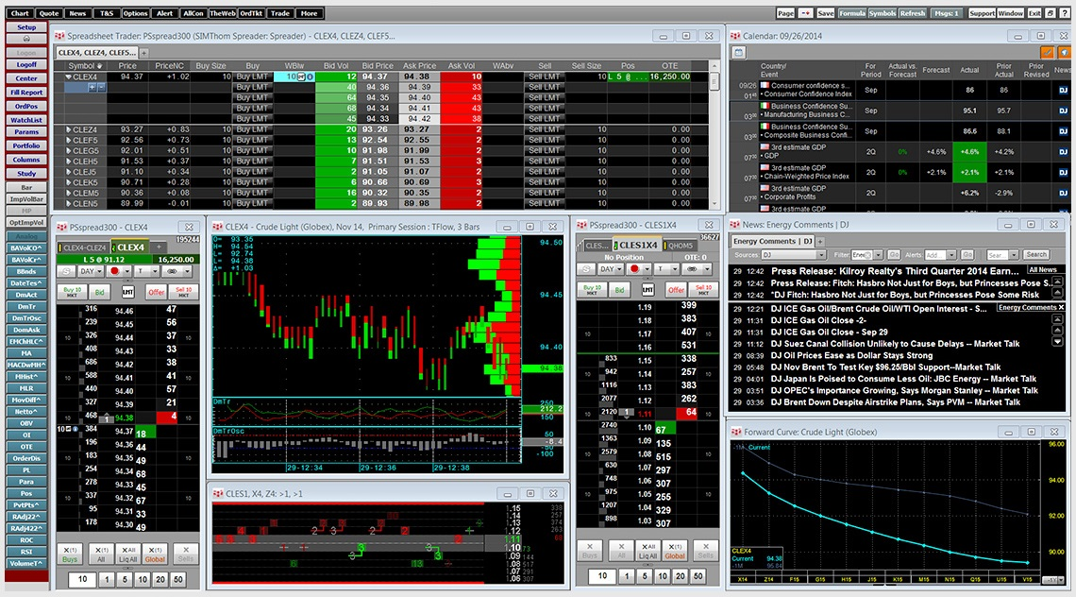



LiveQuotes.co.in
Real-Time Market Data Redistribution Across Multiple Platforms
Real-Time Data
Multi-Platform
Seamless Integration
A Service by Bonrix Software Systems

Slide 2






About the Company
Bonrix Software Systems
Location
A-801, Samudra Complex
Near Klassic Gold Hotel
Off C.G. Road, Ahmedabad
Gujarat, India
Expertise
IT Solutions with focus on:
• Microsoft .NET
• ASP
• J2ME
• Real-Time Data Services
Product Portfolio
• LiveQuotes Data Feed
• SMS Messaging Solutions
• GPS Tracking Systems
• DND/NDNC Scrubbing
Technology expertise
Relationship focused

Slide 3





Company Philosophy and Strengths
Core Strengths
Quality
Stubborn commitment to delivering best-in-class solutions through rigorous standards
Working Philosophy
Adaptability
Giving sets the ground for receiving - we exchange value, not just services
Customized solutions based on client requirements with flexible implementation
We build working relationships, not customer lists
Technology
Good ideas properly implemented are the keys to success
Expertise in modern platforms including .NET, ASP, and J2ME
Rejecting hierarchical models - ideas can come from anywhere and anyone

Slide 4











Service Description
LiveQuotes Real-Time Data Solutions
Web Applications
Desktop & Mobile Apps
Integration Solutions
Administrative website for quotes
Lite desktop application
Excel DDE integration
Fast desktop application
ODBC data sources
Client-facing web interface
Mobile application versions
Odin 2 Post data transfer
SMS view web application
Server-based Excel RTD/DDE
SMS Manager for Odin
Detail view with comprehensive data
Key Service Benefits
Real-time market data streaming
Multi-platform accessibility
Seamless integration options
Fast data processing
Reliable data accuracy
Technical support available

Slide 5




Key Features
Excel Integration
Universal access across all devices and platforms Web applications Desktop applications (Lite & Fast) Mobile applications
Seamless connectivity with Excel through DDE and ODBC data sources Real-time DDE data transfer ODBC database connectivity Server-based Excel RTD
Multi-Platform Support
Real-Time Streaming
Data Transfer Solutions
Instant data delivery with minimal latency Live quotes streaming Market updates in real-time SignalR technology
Efficient data exchange between systems Odin 2 Post transfer Excel 2 Post conversion SMS Manager for Odin

Slide 6





How It Works
1
2
3
4
Market Data Sources
Data Processing
Distribution System
End User Access
NSE, BSE, MCX and other exchanges
Real-time filtering and normalization
Multi-channel data redistribution
Multiple platforms for consumption
Desktop Applications
Web & Mobile Solutions
Lite version for basic users
Administrative web interface
Fast version for power users
Client-facing web portal
Excel integration via DDE/ODBC
Mobile apps for on-the-go access
Server-based RTD functionality
SMS view for quick updates

Slide 7



Benefits
Instant market data with minimal latency for timely decision-making Live quotes streaming Market trends in real-time Competitive edge in trading
Universal availability across all devices and platforms Desktop applications Web interfaces Mobile access on-the-go
Real-Time Access
Multi-Platform Access
Market Intelligence
Seamless Integration
Comprehensive insights for informed decision-making Multi-exchange data Historical trends Customizable alerts
Easy connectivity with existing systems and workflows Excel DDE integration ODBC data sources Custom APIs for developers
Impact on Business Performance
95%
<1s
24/7
40%
Data Accuracy Rate
Average Latency
System Availability
Faster Decision Making

Slide 8




Use Cases and Applications
Stock Brokers
Financial Institutions
Real-time quotes for client trades
Investment research and analysis
Market depth analysis
Algorithmic trading systems
Portfolio tracking updates
Compliance monitoring
Risk management tools
Asset valuation models
Individual Traders
Corporate Entities
Day trading decisions
Treasury operations management
Technical analysis with live data
FX exposure monitoring
Mobile alerts for opportunities
Market intelligence for strategy
Excel integration for custom models
Investment committee reporting

Slide 9











Contact Information
Bonrix Software Systems
Providers of LiveQuotes.co.in
Address
Email
A-801, Samudra Complex
info@bonrix.net
Near Klassic Gold Hotel, Off C.G. Road
bonrix@gmail.com
Ahmedabad, Gujarat, India
sales.bonrix@gmail.com
Phone Numbers
Messaging Apps
Mobile: +91 94290 45500
Google Hangout: bonrix@gmail.com
Mobile: +91 94260 45500
Skype: bonrix_sms / sales.bonrix
Landline: +91 79 26426364
WhatsApp: +91 94290 45500

